Slide 1
OBJECT-ORIENTED METHODOLOGIES

Slide 2
Chapter’s Objective
You should be able to define and understand:
O-O Methodolgies
The Rumbaugh et al. OMT
The Booch methodology
Jacobson’s Methodologies

Slide 3
Object- Oriented Methodology
Object- Oriented Methodology is a set of
Methods
Models
Rules
for developing the system.
Modeling provides a means for conceptualizing and communicating ideas in a precise, easy to understand and unambiguous form.

Slide 4
4.1 INTRODUCTION: TOWARDS UNIFICATION – TOO MANY METHODOLOGIES
BEST PRACTICES ARE UNIFIED- DUE TO TOO MANY METHODOLOGIES:
- Booch-1986 object-oriented design concept, Booch method
Sally Shaler & Steve Mellor (1989 – 91) OO Systems Analysis + Object Lifecycles
Peter Coad & Ed Yourdon (1991) (OOA & OOD) prototype-oriented approach
Wirfs-Brock-1990 Class-Responsibility-Collaboration (CRC) Methodology
Booch/Rational work on Ada (1994 – 95) OO Analysis and Design with Apps.
Rumbaugh (GE) Object Modeling Technique (OMT) 1991
Jim Odell & James Martin ( IS applications )(1994 – 96)
Jacobson (Ericsson) OO Software Engineering (1994-95)
Rumbaugh joins Rational to work with Booch (1994)
Rational bought Objectory & Jacobson (1995)
Through Object Management Group & Rational, UML was born.
UML unifies the methods of James Rumbaugh, Grady Booch, and Ivar Jacobson.

Slide 5
4.2 SURVEY OF SOME OF THE O-O METHODOLOGIES
Rumbaugh et al. method is well suited for describing the object model or the static structure of the system and dynamic model.
The Jacobson et al. method is good for producing user-driven analysis models.
The Booch method produces detailed object-oriented design models.

Slide 6
4.3 RUMBAUGH ET AL’S OBJECT MODELING TECHNIQUE (OMT)
OMT represented by Jim Rumbaugh and his co workers described a method for the analysis, design, and implementation of a system using an o-o technique.
OMT is fast, intuitive approach for identifying & modeling all objects making up the systems.
OMT consists of :
Static(Object), Dynamic(State transistion) and Functional(Process description & consumer-producer) models.

Slide 7
4.3 RUMBAUGH ET AL’S OBJECT MODELING TECHNIQUE (OMT) contd..
OMT consists of 4 phases:
Analysis: The results are objects dynamic & functional models.
System design: Basic architecture & high level strategy of the system.
Object design: Design document produced containing object static, dynamic and functional model.
Implementation: Reusable, extendible & robust code.

Slide 8
4.3 RUMBAUGH ET AL’S OBJECT MODELING TECHNIQUE (OMT) contd..
OMT separates modeling into three parts:
Object model: Presented by the object model and data dictionary.(Class diagrams)
Dynamic model: presented by the state transition diagrams, and event flow diagrams.
Functional model: presented by data flow and constraints. (DFD)

Slide 9
RUMBAUGH OBJECT MODEL
The object model is central to the method and uses a diagram which is similar to the ERDs used in Yourdon. Classes and their attributes and operations are shown, together with relationships between classes.

Slide 10
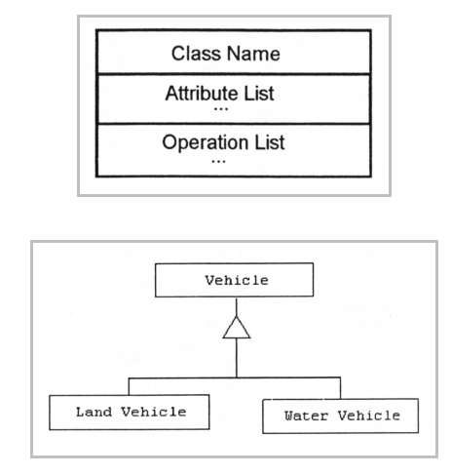
RUMBAUGH CLASS NOTATIONS

Slide 11
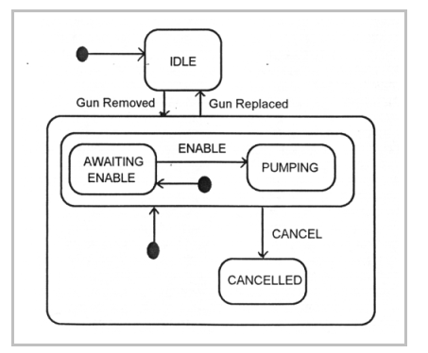
RUMBAUGH DYNAMIC MODEL

Slide 12
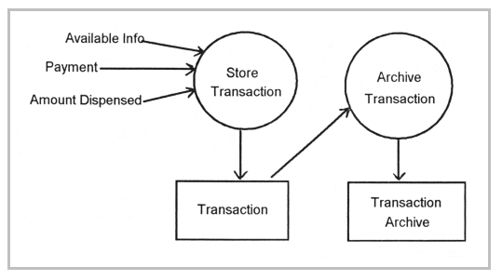
RUMBAUGH FUNCTIONAL MODEL

Slide 13
4.4 THE BOOCH METHODOLOGY
Widely used o-o methods to design systems using object paradigm.
Booch method consists of :
Class Diagrams
Object Diagrams
State Transition Diagrams
Module Diagrams
Process Diagrams
Interaction Diagrams

Slide 14
4.4 THE BOOCH METHODOLOGY contd..
Booch methodology consist of Macro and Micro development process
Macro development process: It serves as a controlling framework for micro process consists of:
- conceptualization
- analysis and development of the model
- design or create the system architecture
- evolution or implementation
- maintenance

Slide 15
4.4 THE BOOCH METHODOLOGY contd..
Each macro development process has its own micro development processes.
Micro process is a day-to-day activities
Micro development process consists of :
- identify classes and objects
- identify class and object semantics
- identify class and object relationships
- identify class and object interfaces and implementation

Slide 16
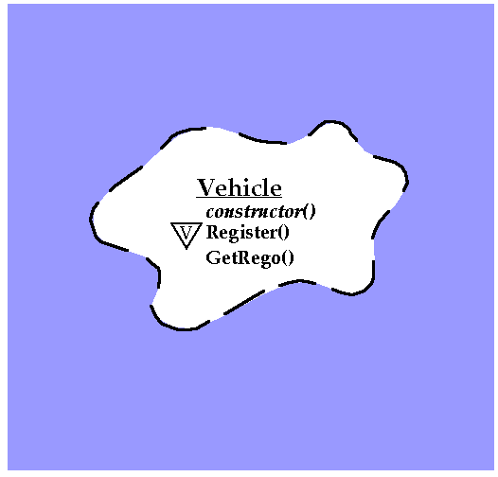
BOOCH NOTATIONS for CLASS

Slide 17
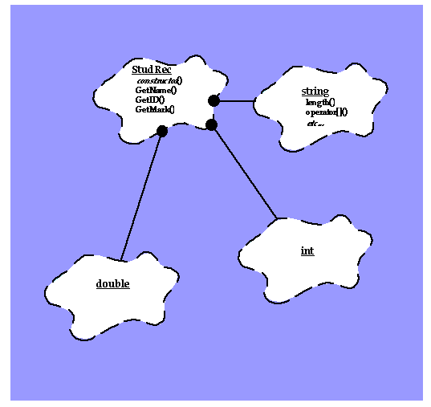
BOOCH NOTATIONS

Slide 18
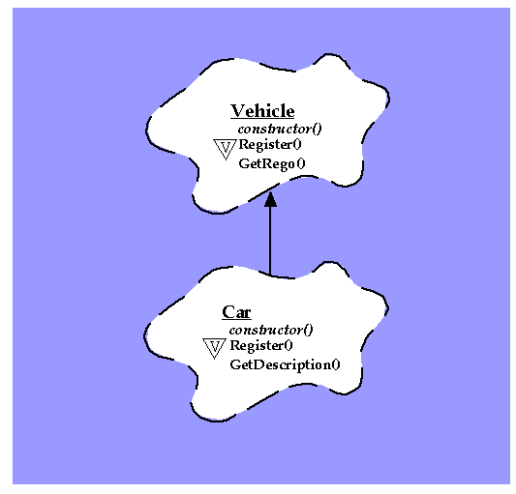
BOOCH NOTATIONS for CLASS INHERITANCE

Slide 19
4.5 THE JACOBSON ET AL. METHODOLOGY
This methodologies covers the entire life cycle and stress traceability between the different phases both forward & backward. It consists of:
OOBE (O-O Business Engineering)
OOSE (O-O Software Engineering) also called:
OBJECTORY (Object Factory for Software Development)

Slide 20
4.5 THE JACOBSON ET AL. METHODOLOGY contd..
Concept of use-case
- scenarios for understanding the system requirements
- is an interaction between user and system
- captures the goal of the user and responsibility of the system to its users

Slide 21
4.5 THE JACOBSON ET AL. METHODOLOGY contd..
The use case description must contain:
How and when the use case begins and ends.
The interaction between the use case and its actors, including when the interaction occurs and what is exchanged.
How and when the use case will need data stored in the system or will store data in the system.
Exceptions to the flow of events.
How and when concepts of the problem domain are handled.

Slide 22
4.5 THE JACOBSON ET AL. METHODOLOGY contd..
Every single use case should describe one main flow of events.
An exceptional or additional flow of events could be added.
The use case model employs extends and uses relationships.
Extend relationship extends the functionality of the original use case (like a subclass).
The Uses relationship reuses common behavior in different use cases.

Slide 23
4.5 THE JACOBSON ET AL. METHODOLOGY contd..
O-O Software Engineering: Objectory
OOSE also called objectory is a method of O-O development with the specific aim to fit the development of large, real time systems.
The development process is called use-case driven process. Used across:
Analysis, Design, Validation & Testing

Slide 24
4.5 THE JACOBSON ET AL. METHODOLOGY contd..
Objectory is built around several different models such as:
Use-case model : The use-case model defines the outside(actors) and the inside(use case) of the system’s behaviour
Domain Object model: The object of the real world are mapped into the domain object model.
Analysis Object model: It presents how the source code(implementation) should be carried out and written.
Implementation model: The implementation model represents the implementation of the system
Test model: It includes the test plans, specifications, and reports.

Slide 25
4.5 THE JACOBSON ET AL. METHODOLOGY contd..
O-O Business Engineering
OOBE is object modeling at the enterprise level. (Use case are also central here)
OOBE consists of :
Analysis phase
Design & Implementation phases
Testing phase: Unit, integration & system testing.

Slide 26
Unified Modelling Language
Modelling helps to visualize , organize, document and understand complex relationships and to produce well designed systems.
3 most popular methodologies OOD (Booch), OMT(Rumbaugh) and OOSE(Jacobson) were combined into Unified Modelling Language.
In Unified Modelling Language, the best concepts and processes were adopted by Object Management Group (OMG) in 1997.

Slide 27
Unified Modelling Language
The UML is defined as a language for visual modelling that allows to specify, visualize , construct , understand and document the various artifacts of the system.
UML models static and dynamic aspects of the system.
The static aspect models the objects and relationship among these objects.
The dynamic aspect of the system , models the events and states used for interaction among objects over time.
“Modelling helps to understand the system from different aspects”

